Slide 1

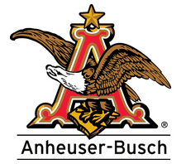
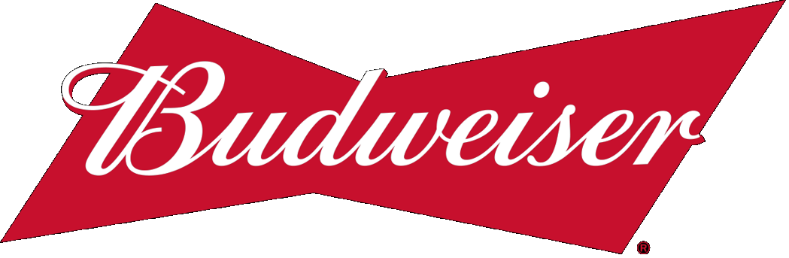
Budweiser craft brewery eda Michael Burgess Rob Pollock
Notes:
Hello. My name is Michael Burgess and on behalf of my partner, Rob Pollock, and myself I would like to thank you for attending our presentation today. I will be going over the results of a guided data analysis that we performed on data related to craft beers and breweries.

Slide 2
Background Information
Asked by the CEO and CFO to explore 2 data sets regarding craft breweries and beers in the United States
2,410 Beers
558 Breweries
Data includes information on:
The name and location of the Brewery (City and State)
The name, alcohol content, style, and bitterness of the beers in the dataset
Alcohol content is measured in ABV and will be referred to as ABV
Bitterness is measured in IBU and will be referred to as IBU
Notes:
This was a guided analysis in the sense that the CEO and CFO of Budweiser had specific questions they were looking for answers to. This shaped both our analysis and our insights. We received 2 data files, one containing 2,410 beers, and one containing information for the 558 breweries that produced those beers.

Slide 3
Issues with Missing Data
Summary of missing data:
Brewery Data Set: No missing data noted (no “NA’s”)
Beer Data Set: 62 (2.5%) ABV Values &1005 (42%) IBU Values Missing
The missing ABV and IBU values were present in the beer data file from the beginning.
The missing values were replaced with the mean ABV and IBU for each beer style.
After this replacement process there were no missing values for ABV and only 52 (2.16%) missing values for IBU.
The missing IBU values were either in very small amounts, 1 or 2 beers, or belonged to very sweet styles of beer such as ciders. We felt comfortable omitting these beers from our analysis.
The beer and brewery data sets were then joined on the Brewery_id in the beer file and the Brew_ID column in the breweries file. We found that no beer was missing information for the brewery that produced it.
Notes:
We first wanted to look at the data itself and we found that in the Beer data set there were 62 (2.5%) missing ABV values & 1005 (42%) IBU values missing. We didn’t want to lose almost half the data set, so we found the mean for each unique style of beer and filled in the missing data with the mean for its style. After this we had no missing ABU values and only 52 missing IBU values. These were from beers that we only had one or two examples of or from very sweet beers like Ciders. We felt comfortable omitting these from the analysis. Although we saw very few outliers, the mean should be used with caution because extreme values can skew it but we did not see evidence of that in this analysis. We then joined the brewery and beer sets and found no missing values created by this join. That is, every beer had information about the brewery that made it.

Slide 4
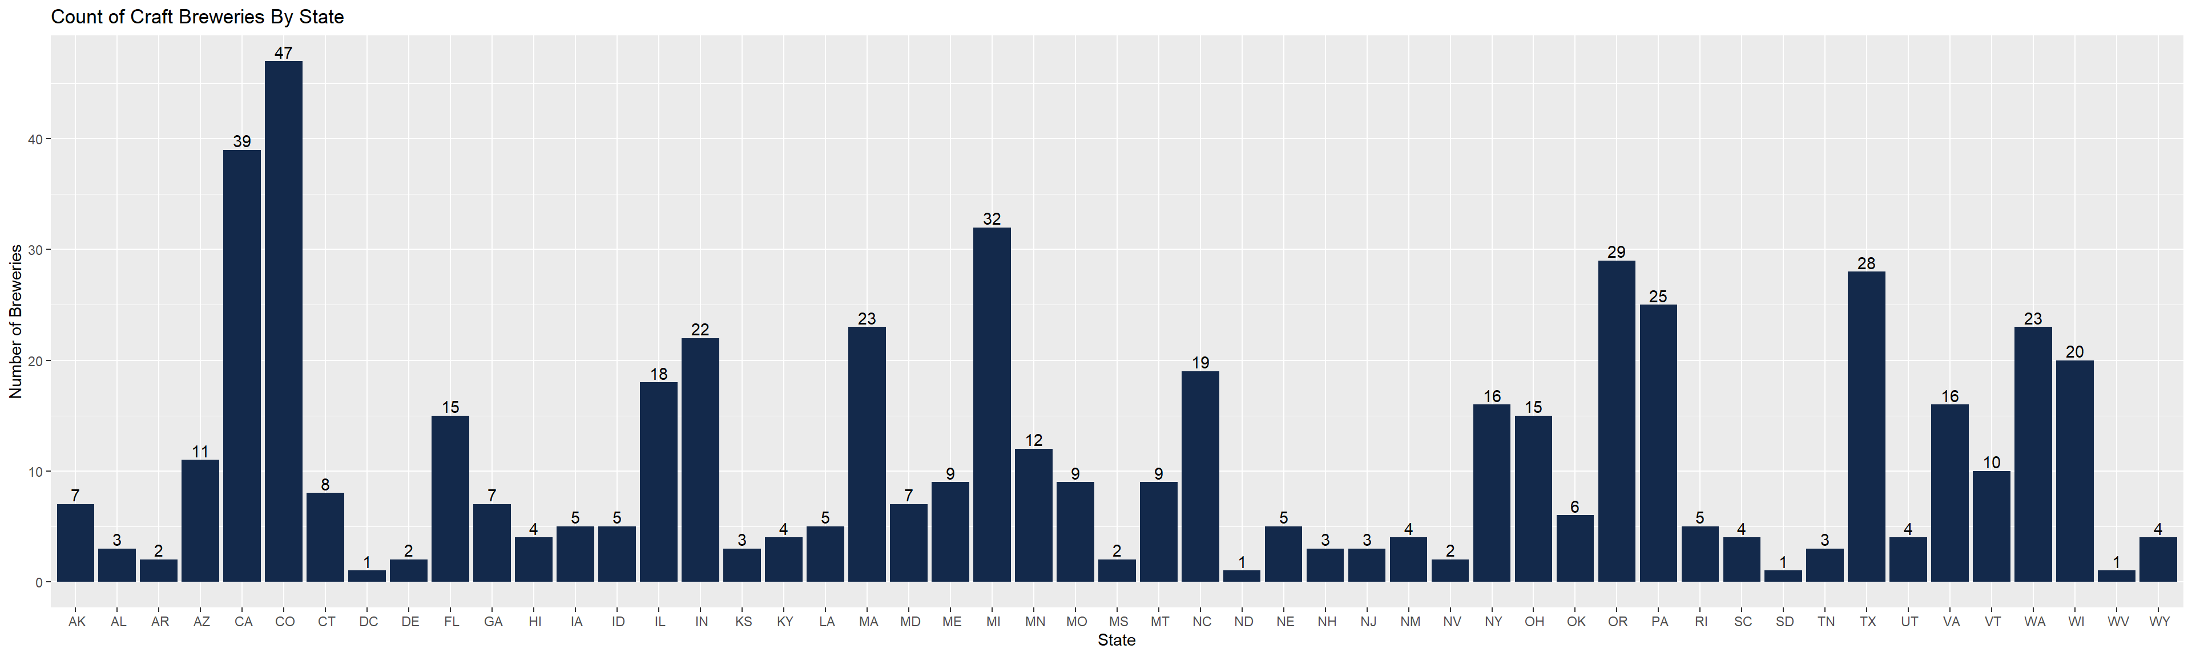
Number of Craft Breweries By State
We plotted how many breweries were present in each state out of the 558 total breweries we had data for:
Are these markets we should be competing in?
Notes:
For our first question we were asked to explore how many craft breweries were present in each state. We can see values as extreme as 47 or 39 in states like Colorado and California and as small as 1 or 2 in states such as South Dakota and Delaware. This can tell us a lot about the market for craft beers in these states. There may be a strong demand for craft beers somewhere like Colorado, but is that market too crowded to compete in? Conversely, is there little demand in places like South Dakota or are companies not meeting the demand that’s already there?

Slide 5
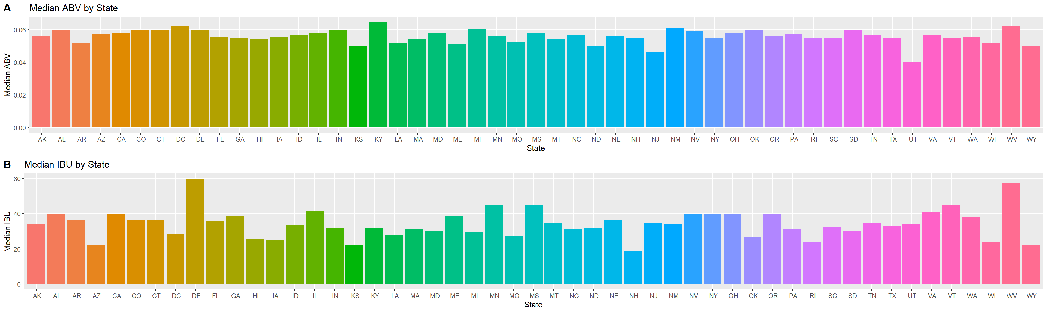
Median ABV and IBU by State
The following charts show the median (middle) ABV and IBU across all beer styles for each state
What does this tell us consumers are looking for?
Notes:
To get an idea of what consumers are looking for from their beers we then looked at the median (middle) ABV and IBU across all beer styles for each state. We see that with a few notable exceptions most states fall between 5 – 6% ABV and roughly 25 – 40 IBU. This may give us a strong idea of what beers are most popular in each state and what customers are looking for. Budweiser falls just below this range at 5% ABV and 12 IBU for Budweiser and 4.2% ABV and 6 IBU for Bud Light.

Slide 6
Maximum abv and ibu
Looking across all beer styles we found the following beers that represented the maximum ABV and maximum IBU value
The beer with the maximum ABV at 12.8%:
Lee Hill Series Vol. 5 – Belgian Style Quadrupel Ale
Quadrupel (Quad)
Upslope Brewing Company Boulder, CO
The beer with the maximum IBU at 138:
Bitter Bitch Imperial IPA
American Double / Imperial IPA
Astoria Brewing Company Astoria,OR
Remember these are outliers for a reason
Notes:
On the opposite end of the spectrum, we also explored the extreme outliers. We found that the beer with the highest ABV at 12.8% was the Lee Hill Series Vol. 5 – Belgian Style Quadrupel Ale produced in Boulder, Colorado. We also found that the most bitter beer at 138 IBU was the Bitter Bitch Imperial IPA produced in Astoria, Oregon. It is important to remember that these are outliers and don’t necessarily represent the data or what consumers are looking for. These were probably one offs like novelty products, a limited run, or maybe something created for a tasting room and show what’s possible, but not necessarily something that there’s a large demand for.

Slide 7
Summary Statics FOR ABV
We next explored some summary statistics for ABV across all beer styles:
The minimum ABV found was 0.1%
The maximum ABV found was 12.8%
The median ABV was 5.6%
The mean ABV was 5.98%
602 beers between 5% and 5.6%
Min | 1st Qu. | Median | Mean | 3rd Qu. | Max | Std Dev
0.1% | 5% | 5.6% | 5.98% | 6.7% | 12.8% | 1.35%
Is 5.6 ABV% our model beer?
Notes:
We next looked more closely at the value of ABV itself. We found that the minimum ABV content was at 0.1% and that the maximum was again at 12.8% The median fell at 5.6%, while the mean was slightly higher at 5.98%. We find that 25% of the beers, 602 beers, fall in this very narrow range between 5 and 5.6% ABV, compared to the 600 beers between .1 and 5%, for example. This may be strong evidence that there is much more demand for beers in this 5 to 5.6% range than at other ABV Values and this matches our graph of the median ABV by state we saw earlier.

Slide 8
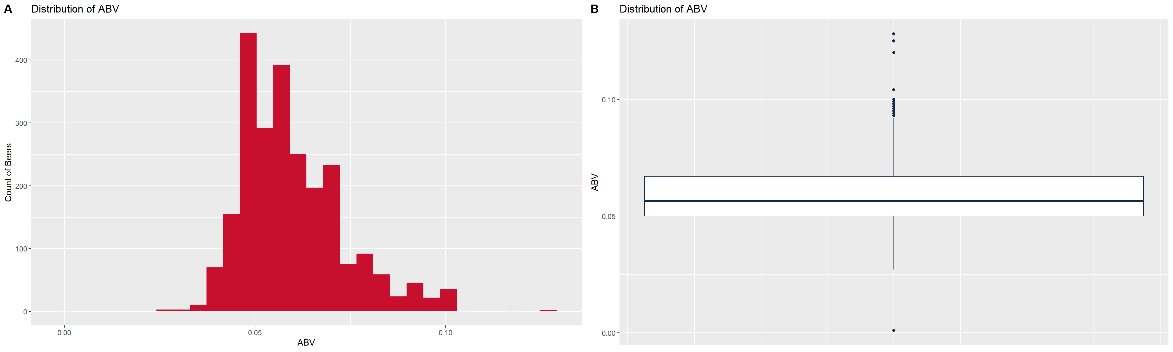
distribution of Abv across all beers
These plots show the distribution of ABV for all beer styles. Again, we see the majority of beers clustered between roughly 5% to 6% ABV and gradually tapering off towards more extreme values.
The boxplot helps us visualize the statistics from the previous slide. We see the median ABV at 5.6% and again we see how small the distance between the 1st quartile and median is
Notes:
In these 2 plots we are able to better visualize what ABV looks like across the entire data set. In the histogram on the left, we see a very large number of beers, the y axis, centered between 5 to 6% abv, the x axis, and then a gradual tapering off of the number of beers as we approach more extreme ABV values. The box plot on the right helps us to visualize the quartile range from the previous slide and shows the very tight concentration of data contained between 5 and 5.6% abv. It also helps us to visualize the more extreme outliers contained in the data.

Slide 9
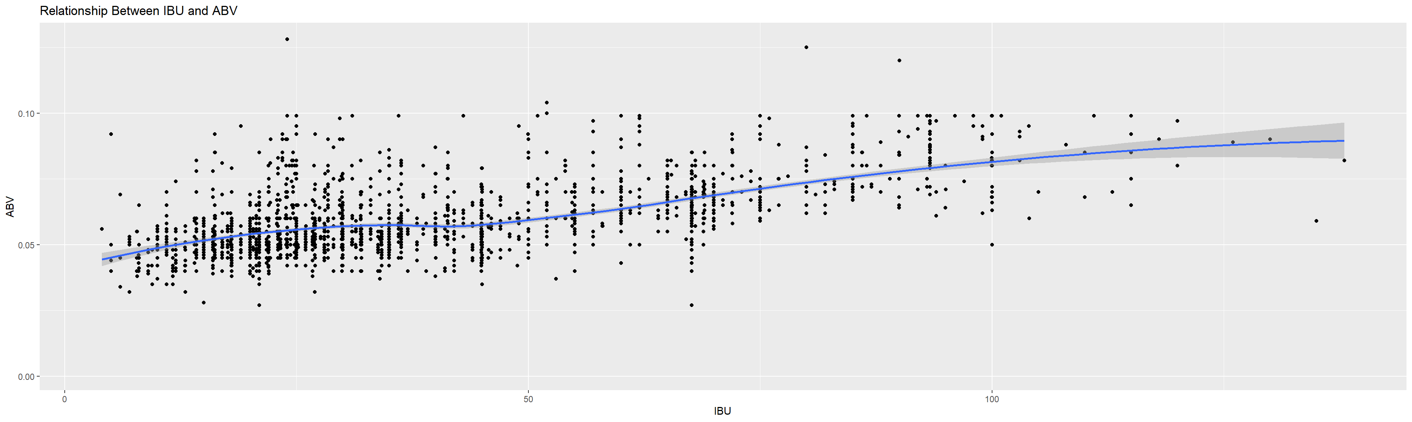
relationship between abv and ibu
It appears that there is little to no correlation between IBU and ABV:
For beers between roughly 0 and 25 IBU we see a gradual increase in the ABV
At 25 to 50 IBU the trend stays relatively consistent with ABV close to 5%
There is a stronger linear trend between 50 and 100 IBU with ABV increasing consistently
Over 100 IBU the relationship is fairly flat again
Notes:
We next tried different models to see if there was a relationship between IBU and ABV. That is to say that a variation in the IBU would cause a variation in the ABV and we see very little evidence of this relationship. There’s a miniscule increase in the ABV between 0 and 25 IBU, but there’s very little variation in the ABV at 25 to 50 IBU with most of the data concentrated around 5% ABV, like we’ve seen previously. There’s more of a linear relationship between 50 and 100 IBU with the trend becoming flat again over 100 IBU. We think that this is more than likely an example of a brewer trying to produced a balanced beer or flavor profile than any indication of a relationship between IBU and ABV and that makes sense: although IBU and ABV are both components of a beer, one doesn’t cause the other. That’s the brewer’s decision.

Slide 10
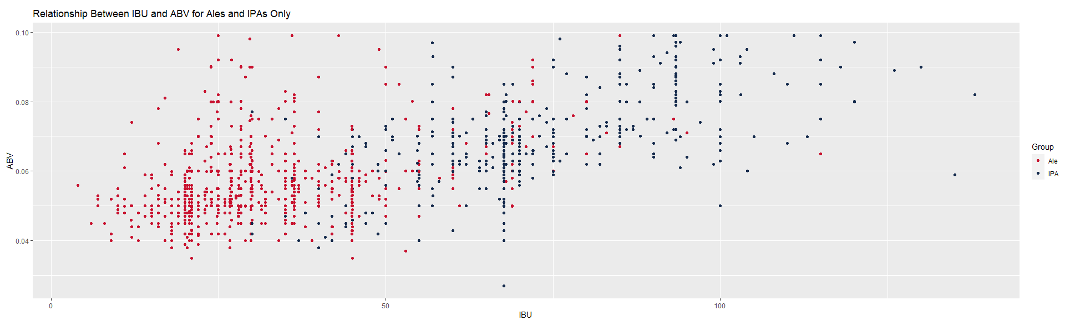
using abv and ibu to predict beer type
k-Nearest Neighbors (kNN) allows us to use the existing data to predict whether a beer is an IPA or an ale
We grouped the beers by style and split the data set into training and test sets
70% of the data in the training set
30% in the test set
We use ABV and IBU to plot the data in the training set and then we plot a data point for each beer in the test set using its unique ABV and IBU values
We compare the test point to so many of its neighbors. The number of neighbors is k and we define this value to adjust our accuracy.
Majority rules and classification is determined by the group that has the most data points in our group of k number of neighbors
Notes:
We next applied a machine learning model called k Nearest Neighbors, kNN, to help us understand the relationship between IBU and ABV for a given style of beer. kNN allows us to use our existing data to predict whether a beer is an IPA or an ale. We grouped the beers into either IPAs or Ales by their style and then split the data into training and test sets, with 70% of the data in the training set and 30% in the test set. In kNN we plot the data in the training set and then plot the point of the beer we want to predict. We compare the test point to so many of its neighbors, K, and we can adjust K to improve our accuracy. Majority rules and the style is determined by the group that has the most data points out of our k number of neighbors. For example if we used k equals 3 and 2 of the beers were Ales, we would classify the test beer as an ale. If 2 of the 3 were IPAs we would classify the test beer as an IPA and so on for every beer we want predict.

Slide 11
using abv and ibu to predict beer type
We found that k = 5 gave us the best accuracy and that accuracy quickly trailed off for larger values of k
To eliminate extreme values for the accuracy of our model, we ran the kNN test 100 times using different random samples of the data to produce different tests each time.
We then took the mean values for accuracy, sensitivity, and specificity across all 100 tests.
Using k = 5 we were able to predict whether a beer in the test set was an ale or an IPA with a mean accuracy of about 91%. That is to say, the model identified 91% of the 473 test beers correctly.
The model showed a mean sensitivity of approximately 92%. This means that it identified 92% of the ales as ales.
The model showed a mean specificity of approximately 87%. This means that it was able to identify 87% of the IPAs as IPAs.
Customers know what to expect when a label says Ale or IPA
Notes:
We ran hundreds of tests for different values of K and found that 5 neighbors gave us the best and most consistent accuracy. We then ran our kNN test 100 times with K equal to 5 and using random samples of the data each time. We then took the average values of the accuracy, sensitivity, and specificity. We could have only used one test, but we wouldn’t have any way of knowing how extreme the values in the test might be or how accurate our model actually was. We found that the mean accuracy was 91%, meaning the model correctly identified the style of 91% of the 473 test beers. The model performed slightly better for ales, identify 92% of the ales correctly, and slightly worse for IPAs, identifying 87% of the IPAs correctly. Intuitively this makes sense: when you open a beer whether it’s a lager, an ale, a porter, or an IPA you have a good idea of what to expect. ABV and IBU are strong components of the profile for any given style of beer and we see that relationship strongly reinforced by our kNN model.

Slide 12
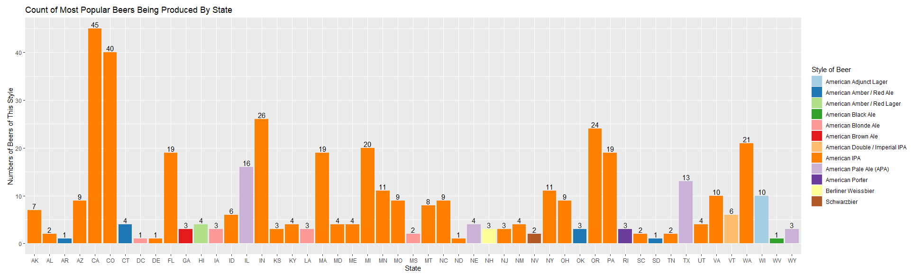
Additional insights
We were also asked to look at an additional insight that the data might provide
We choose to plot the top beer produced for each state and how many of that style of beer were in our data set
What markets should be targeted with what beer?
Notes:
Lastly, we were given some free reign to look for other insights in the data and we choose to look at the most popular beer style for each state. We can see that the American IPA is the clear winner with states like California and Colorado producing 45 and 40 different American IPAs respectively. Budweiser might want to consider targeting these markets with a style of beer specifically tailored to what’s popular there and what’s driving consumer demand.

Slide 13
In summary
Guided analysis through 2,410 beers and 558 breweries
Lots of missing data for IBU and ABV. We replaced it with the mean for each unique style of beer.
States like California and Colorado have a very large number of craft breweries. Should we target these markets?
Using the median and other statistics, we saw over and over that beers tend to be between 5 and 5.6% ABV and 25 to 50 IBU
There are extreme outliers, but these probably don’t represent what most people want
There’s almost no relationship between ABV and IBU: Changing one doesn’t automatically change the other
kNN tells us that there is a very strong link between ABV and IBU for any given style of beer. Customers should know what to expect based on what a beer says it is.
The American IPA is currently the most popular style across many states. There may be great opportunities to target unique or limited run products to these consumers.
Notes:
Finally, to bring it all together and recap what we’ve covered today. We conducted a guided data analysis shaped by questions asked by the CEO and CFO of Budwesier. In this data we found a small amount of the data was missing information for ABV and almost half of the data was missing values for IBU. We calculated the mean for each style of beer and used this to fill in the missing pieces. We saw that states like California and Colorado have a very large number of craft breweries and asked if these are markets that Budweiser should consider targeting with unique products. Through the median and other statistics, we showed that beers tend to fall in a narrow range of 5 to 5.6% ABV and 25 to 50 IBU. We looked at some extreme outliers, but noted that this probably isn’t what most people are looking for. We also tried to find a relationship between ABV and IBU and found that changing one doesn’t automatically cause the other to change. This variability is probably the result of brewers trying to achieve a certain style or flavor profile in their beers. We looked deeper at how IBU and ABV affect style and found that using only these 2 variables we could predict the style of a given beer with 91% accuracy. This tells us that IBU and ABV play a huge part in what makes a style of beer unique and that customers should know what to expect based on the style of the beer. Finally, we looked at the most popular style of beer in each state and found that the American IPA was the clear winner. Budweiser may want to consider targeting markets like California and Colorado with a unique product line tailored to their unique tastes.

Slide 14
Thank you for your time Michael Burgess Rob Pollock
Notes:
On behalf of my partner Rob and myself, thank you again for attending our presentation today. I hope that this has been informative and if you have any questions, please don’t hesitate to reach out to us. Thank you again.

Slide 15
Youtube link
https://youtu.be/GzZx2VFXty0

Slide 16
References
Anheuser-Busch - St. Louis, MO - Beers and Ratings | Untappd

